Slide 1
KUNDI ROCKERS
By :
KUNAL VASUDEVAN
AFSAR IMAM
SHAGUN PANDEY
VIKRANT V JOLIYA

Slide 2
TOPIC
Sentiment Analysis (Amazon Comprehend)
Translate (Amazon Translate)
Text To Speech ( Amazon Poly)
Chat Bot (Amazon Lex)

Slide 3
Introduction
Sentiment Analysis : Using sentiment analysis we can analyse the text data of a file.
Translate : Using boto3 library we have created a program that used to translate one language to any other targeted language.
Text To Speech : in this program whatever the text that is written in a file it will be read out in audio form.
Chat Bot : A program which is used to communicate between program and user and customer

Slide 4
MOTIVATION
Sentiment Analysis : As we all know that we are studying text mining in which we are doing text analysis, to make our work easier we are using sentiment analysis .
Translate : I got the motivation to do the program of converting one language to another because, as we all know that the current course that we are pursuing is from Asia university, that is situated in Taiwan and currently I'm in India. so, I thought it will be very easy and Feasible to create an application That helps you to translate language.
Text To Speech : we all belong to different region, so we have communication issues ,Although we know a common language like English but due to our region, We have different pronunciation for same word. To solve this issues, we have created text to speech program.
Chat Bot : Communication between person to person takes time to reduce this time be a created board that will communicate with the user and jeeva's answers accordingly for example we have done for pizza ordering system .

Slide 5
Sentiment Analysis (Amazon Comprehend)

Slide 6
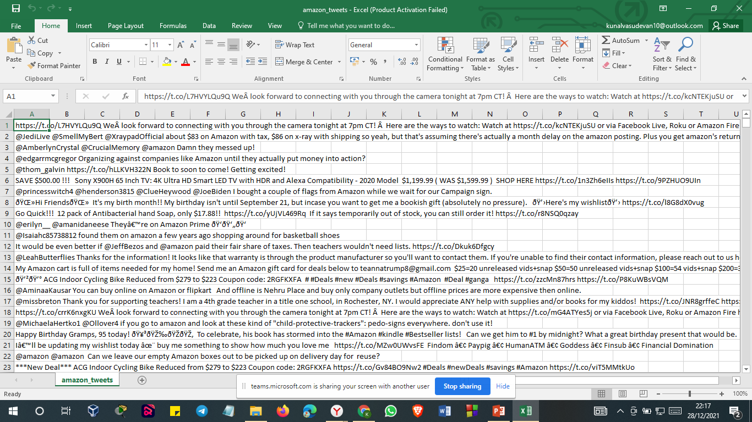
Completeness of corpus content (the amount of texts)

Slide 7
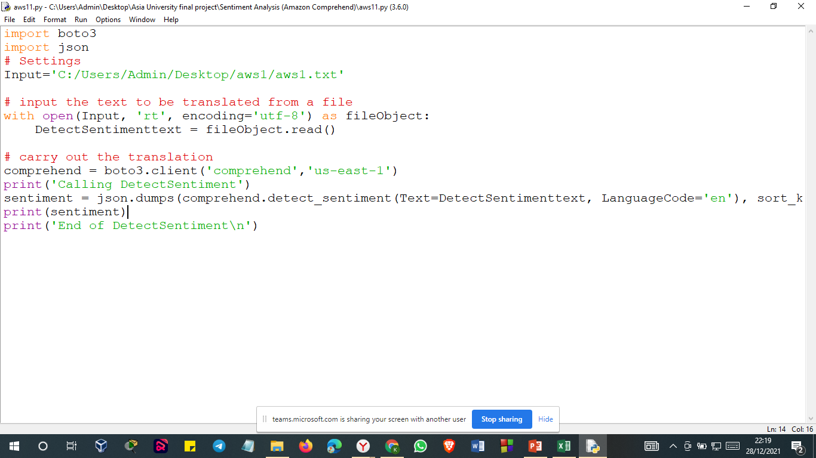
SCREENSHOT OF CODE

Slide 8
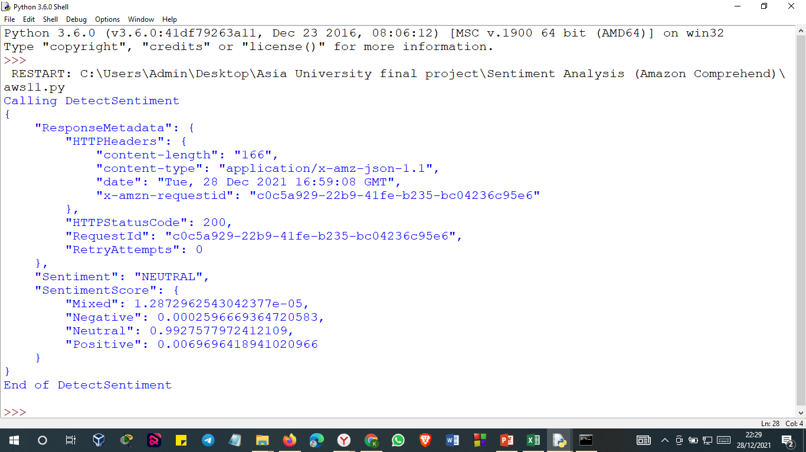
SCREENSHOT OF OUTPUT

Slide 9
TRANSLATE (AMAZON CLOUD9 using Boto library)

Slide 10
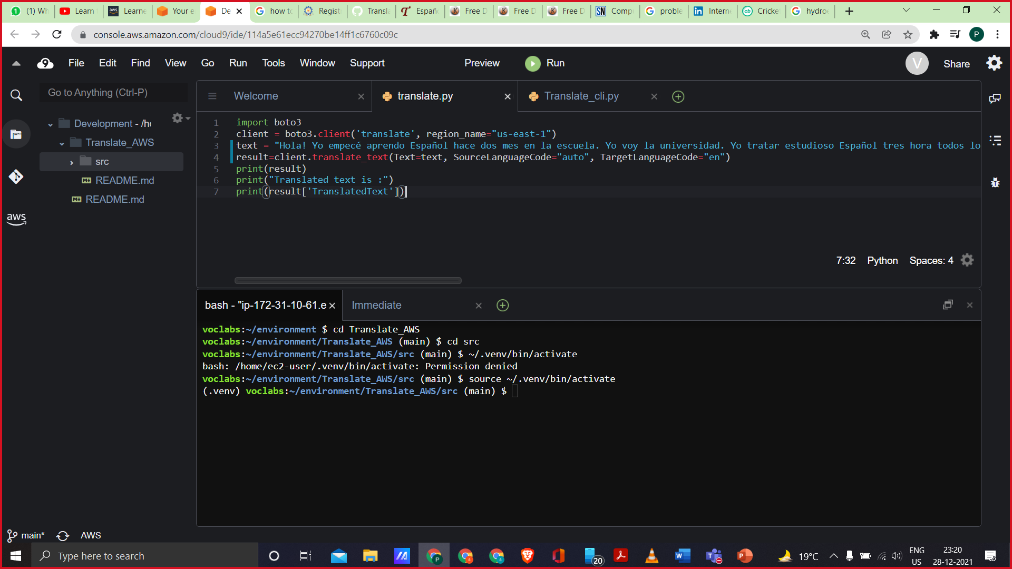
CODE
CODE-1
Input in program

Slide 11
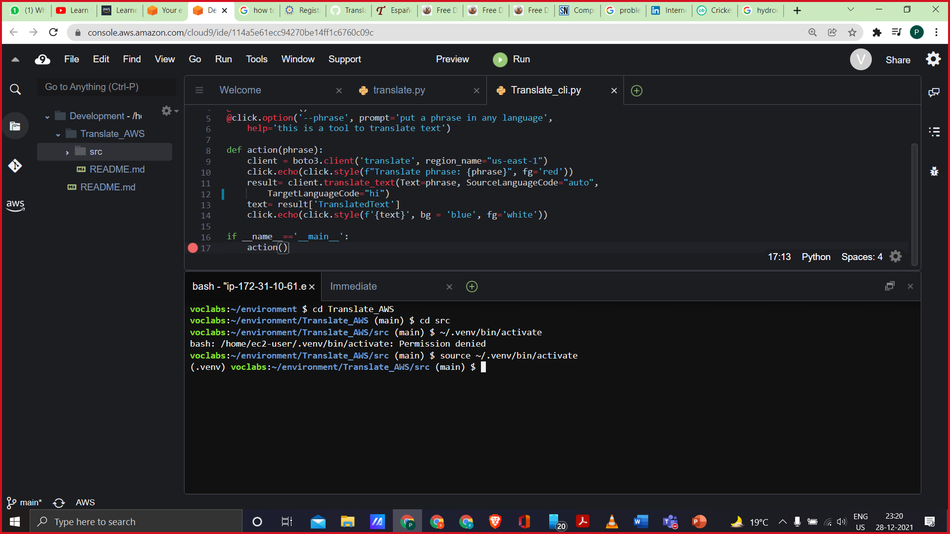
CODE-2

Slide 12
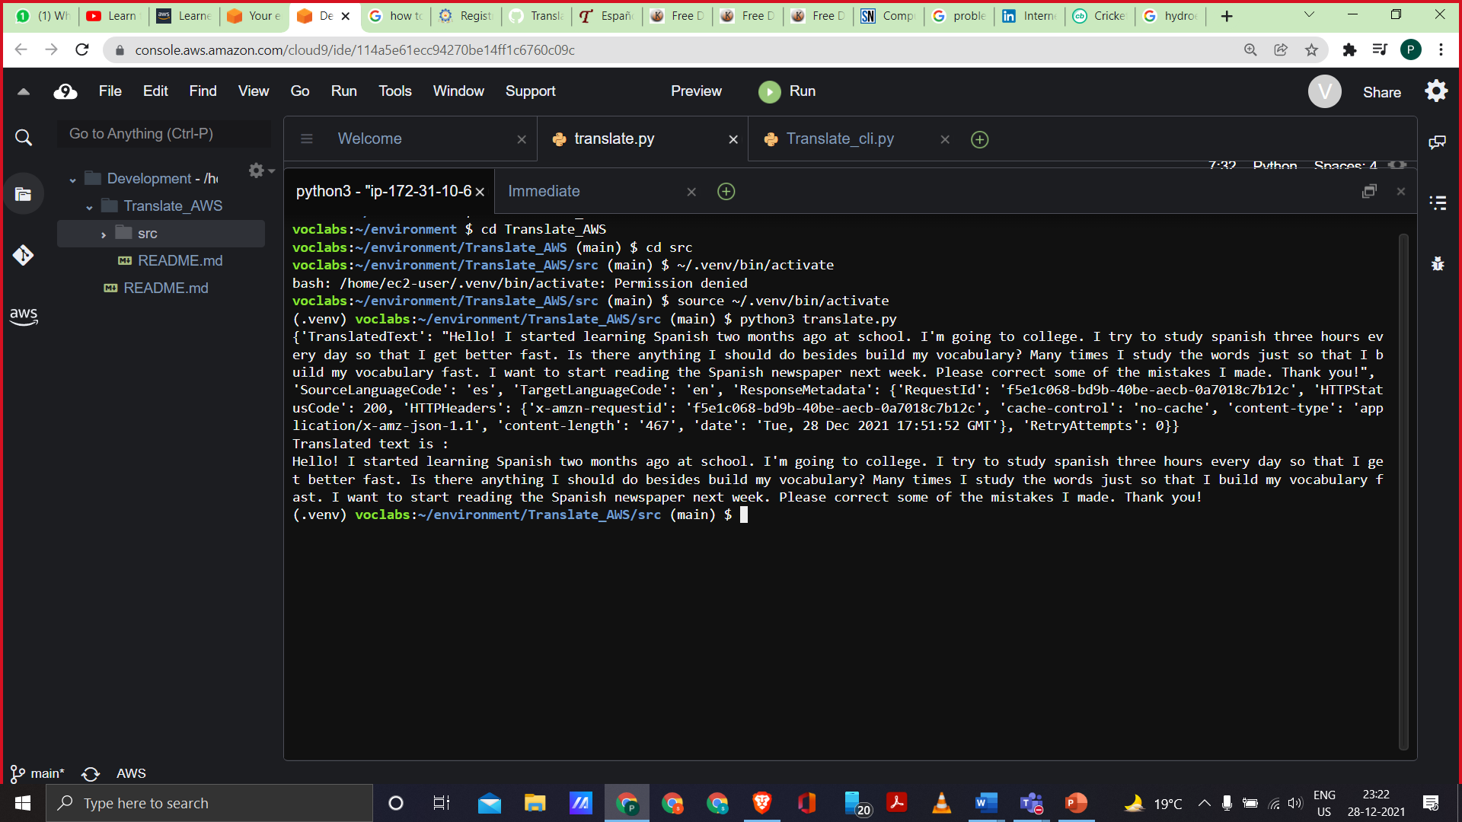
OUTPUT-1

Slide 13
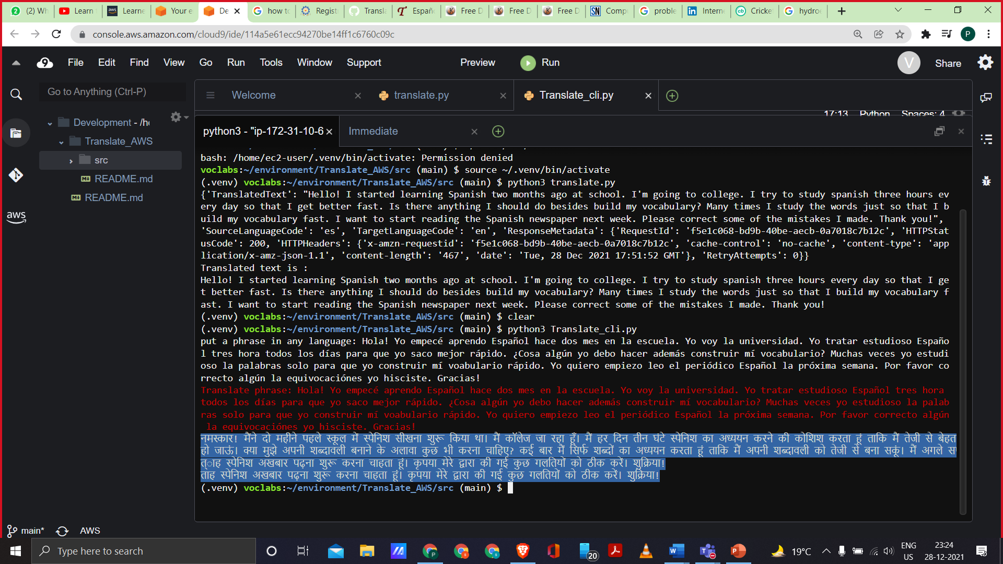
OUTPUT-2
Input Given by user in Spanish
OUTPUT in hindi

Slide 14
Text To Speech ( Amazon Polly)

Slide 15
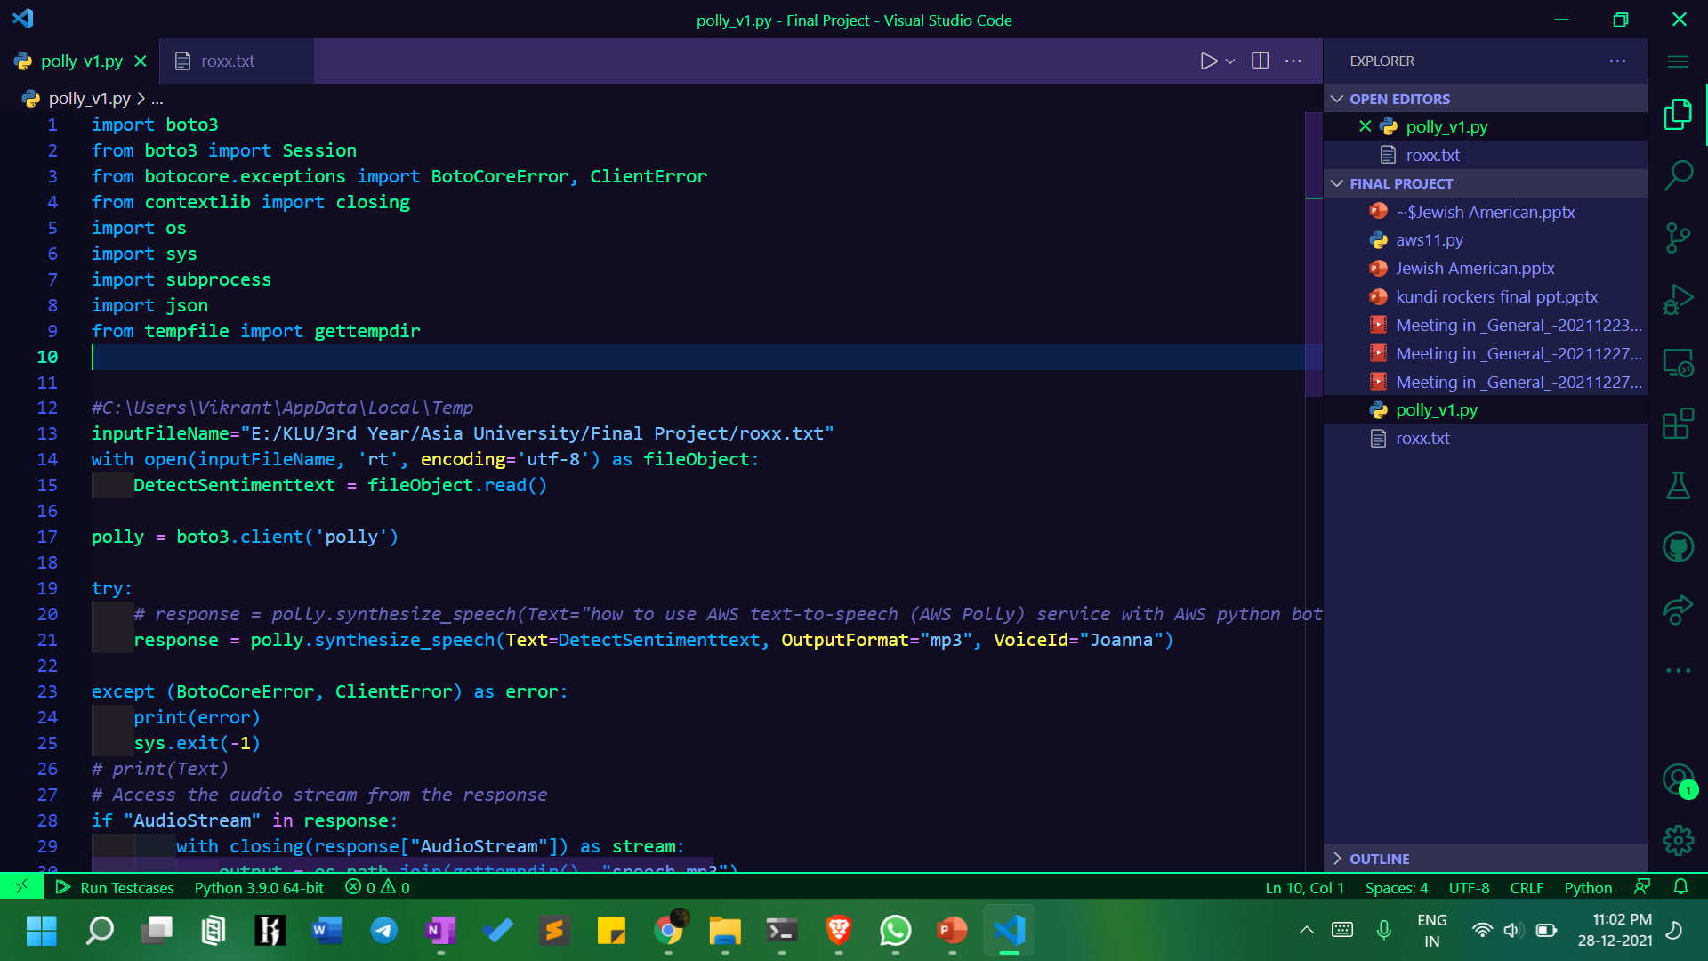
Code

Slide 16
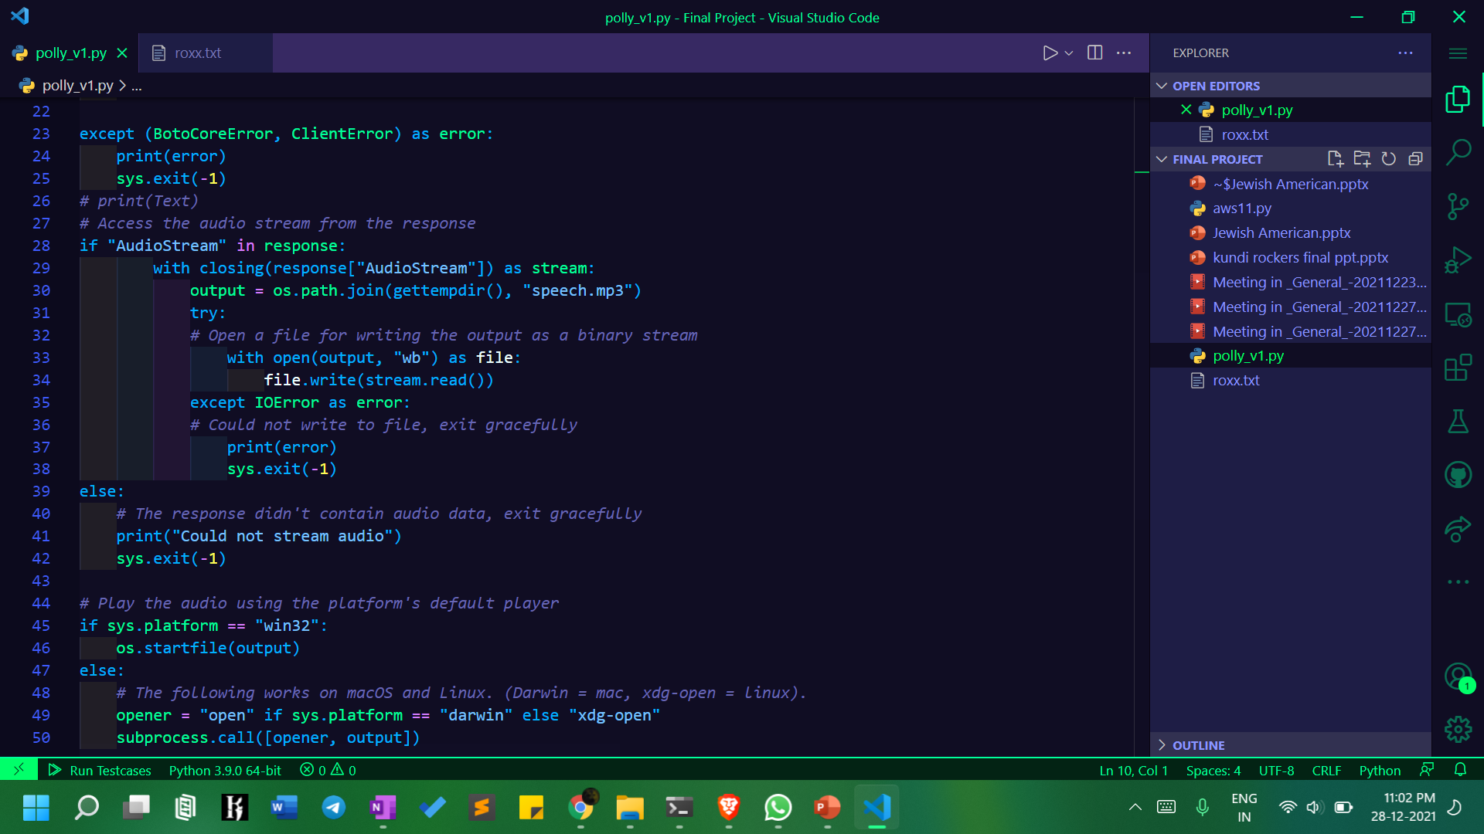
Code

Slide 17
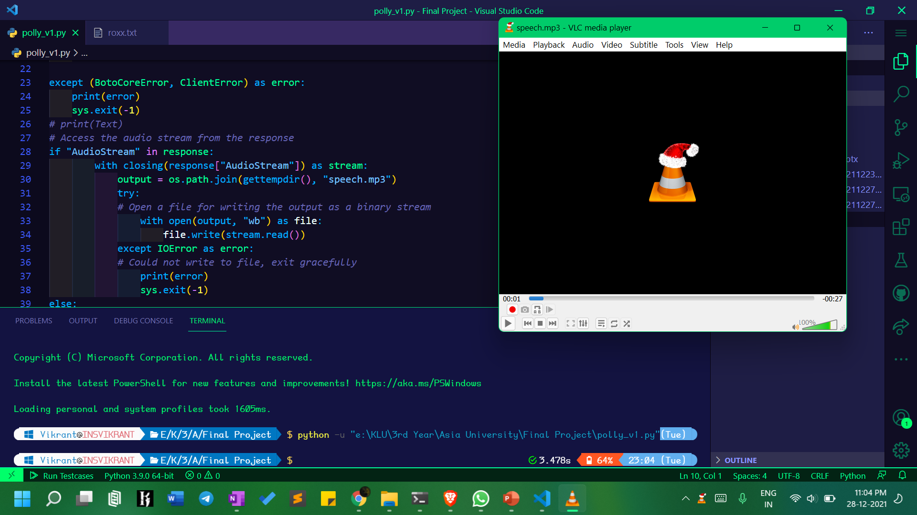
Output

Slide 18
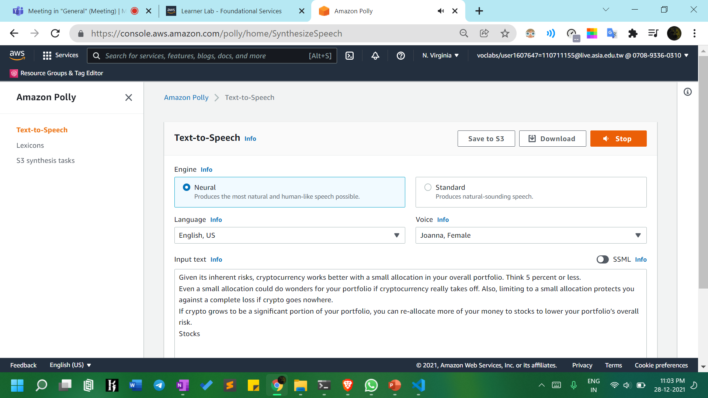
POLLY

Slide 19
CHAT BOT ( Amazon LEX)

Slide 20
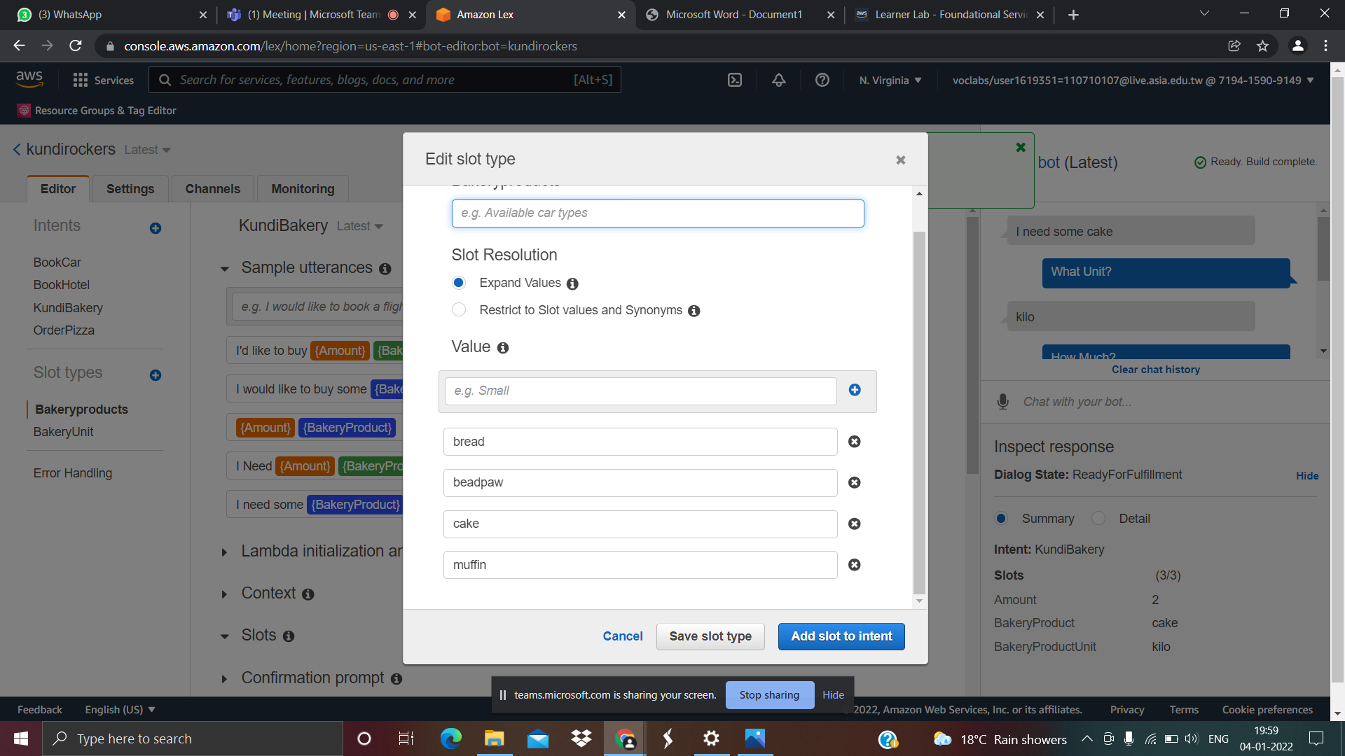

Slide 21
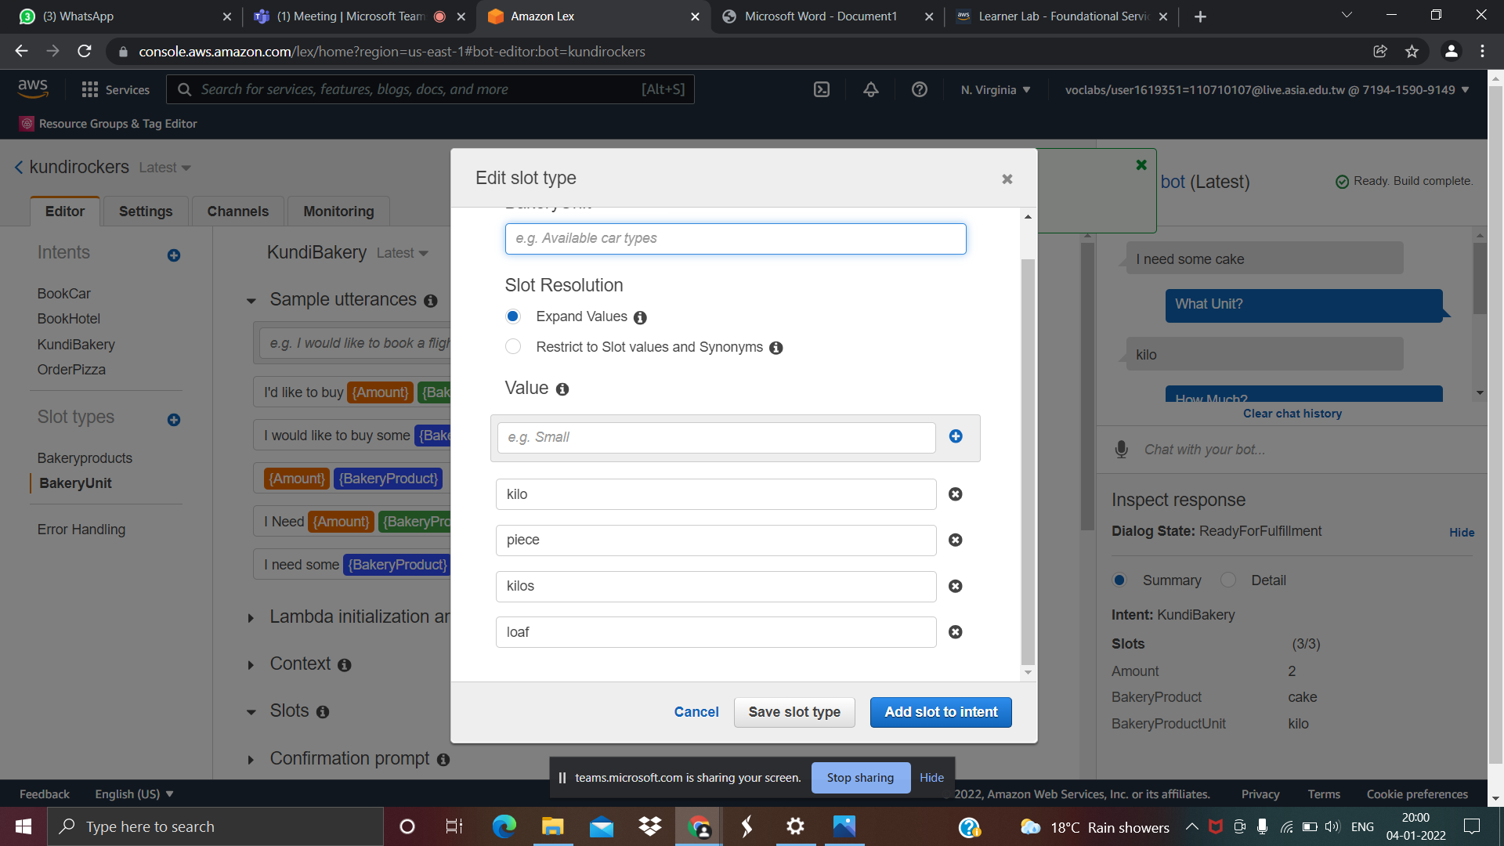

Slide 22
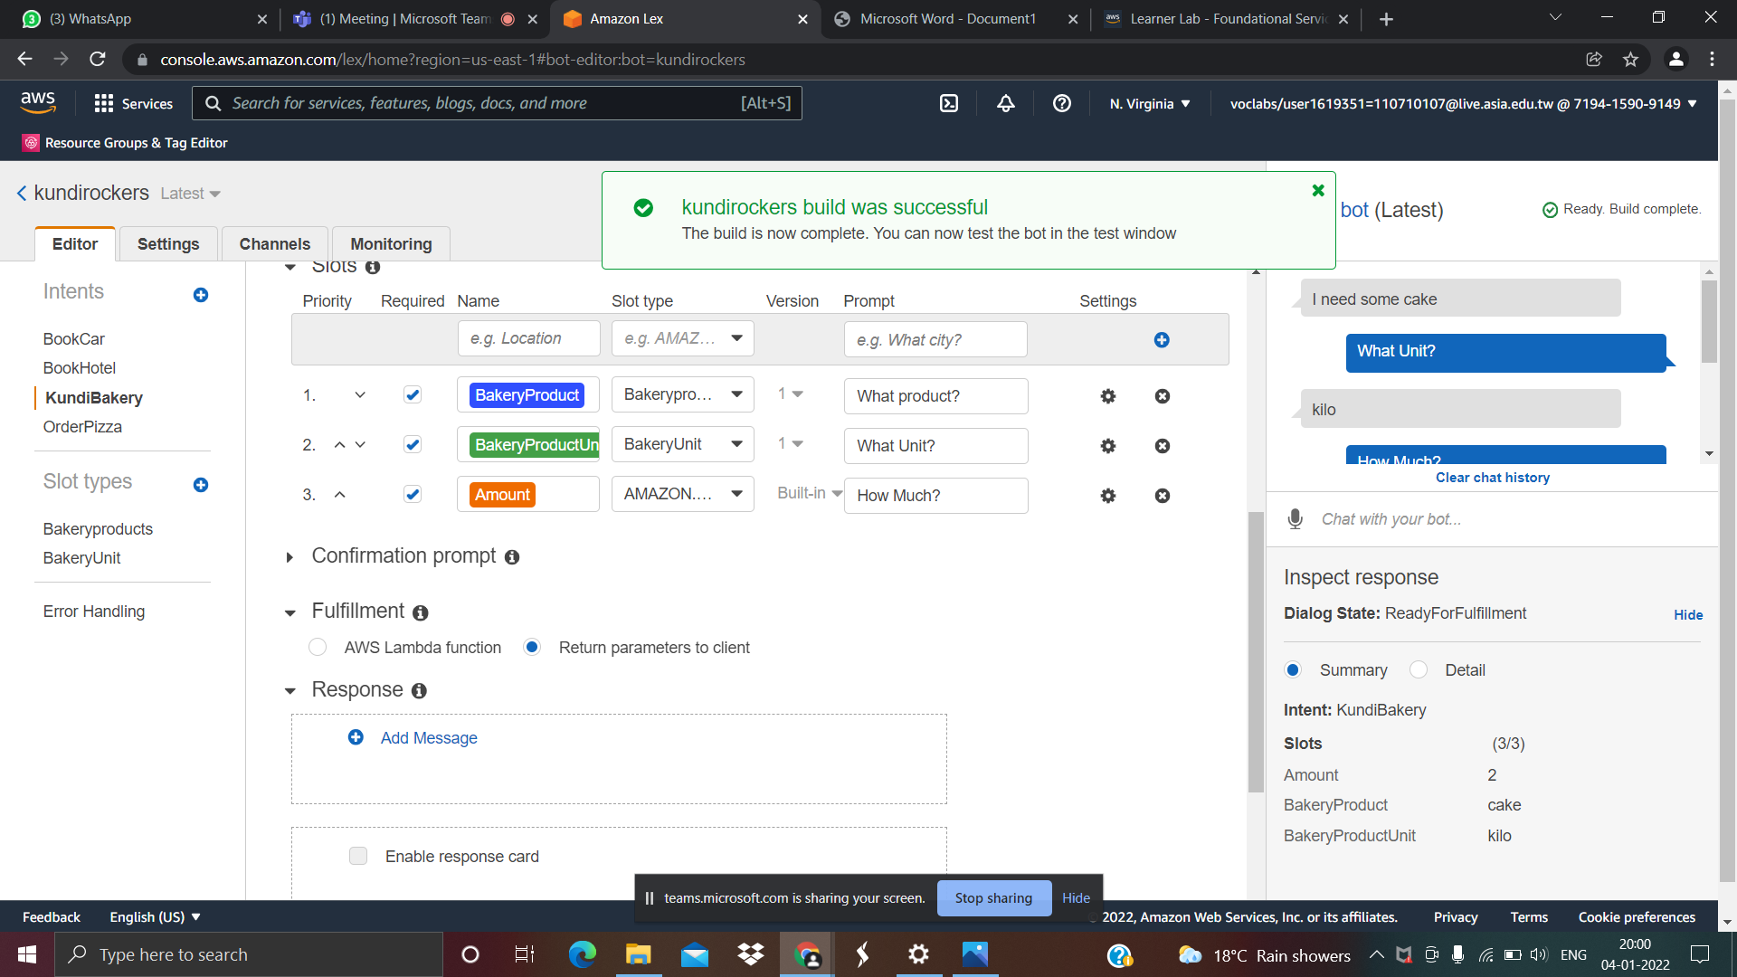

Slide 23
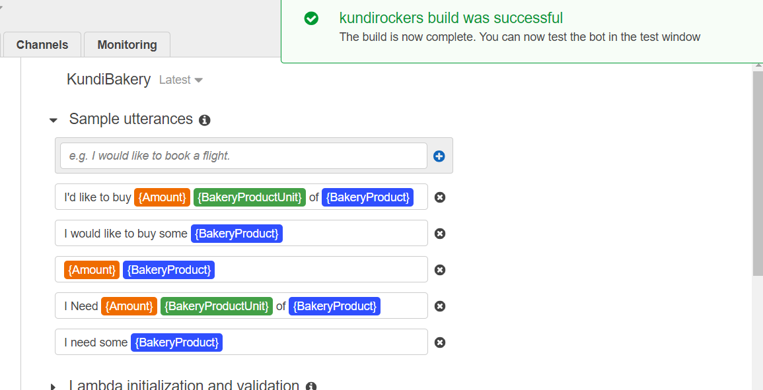

Slide 24
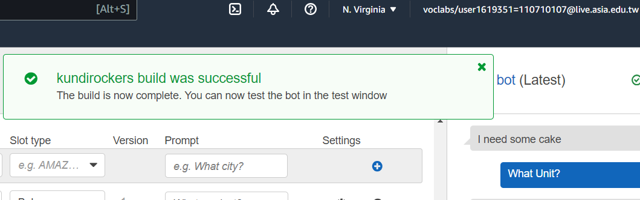

Slide 25
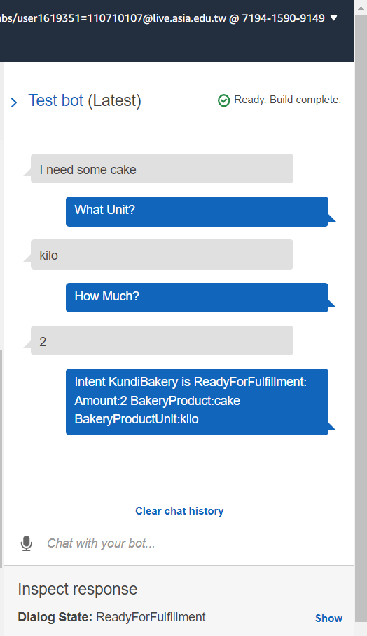

Slide 26
THANK YOU

